Slide 1

AE 460
REPAIRS AND MAINTENANCE OF AGRICULTURAL MACHINERY
Unit 2
Prof. Emmanuel Y.H. Bobobee
emmanuel.bobobee@gmail.com // 0245431872

Slide 2
AE 460 R&M (lecture 2)
Notes on Cooling

Slide 3
When fuel burns inside the cylinder of an ICE, there is a rise in temperature equal to 1600ºC , which if unchecked would be sufficient to melt engine parts.
Temperature must be reduced to 90ºC through cooling
Engine cooling system does two things:
Prevents over heating
Regulates temperature
Over heating could burn up the engine parts. Some heat is needed for combustion, but too much heat is generated.
Regulating temperatures keeps the engine at best heat level for each operation. During starting, the engine must be warmed up faster. During peak operation, the engine must be cooled.

Slide 4
Running engines too hot or too cold
Running engines too hot can cause:
Pre-ignition
Detonation
Knock
Burned pistons and valves
Running engine too cold can cause:
Unnecessary wear
Poor fuel economy
Accumulation of water and sludge in the crankcase.

Slide 5
Types of cooling systems
Cooling systems are classified on the basis of the coolant used:
  Air cooled
  Water cooled
  Combined-air-water cooled

Slide 6
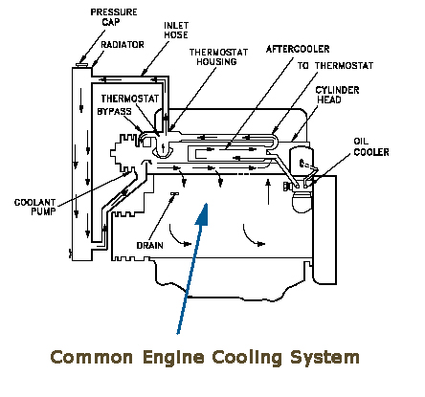

Slide 7
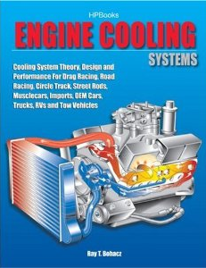

Slide 8
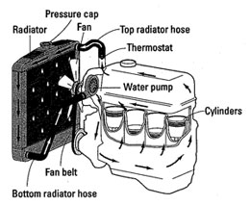

Slide 9
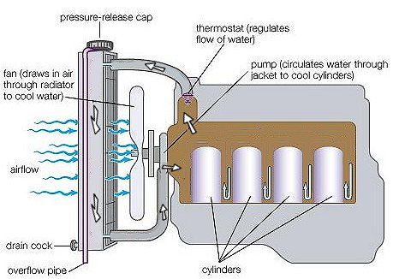

Slide 10
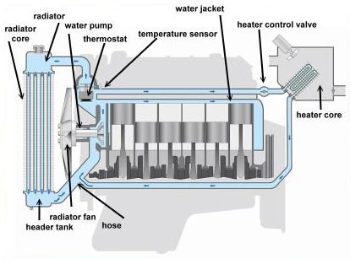

Slide 11
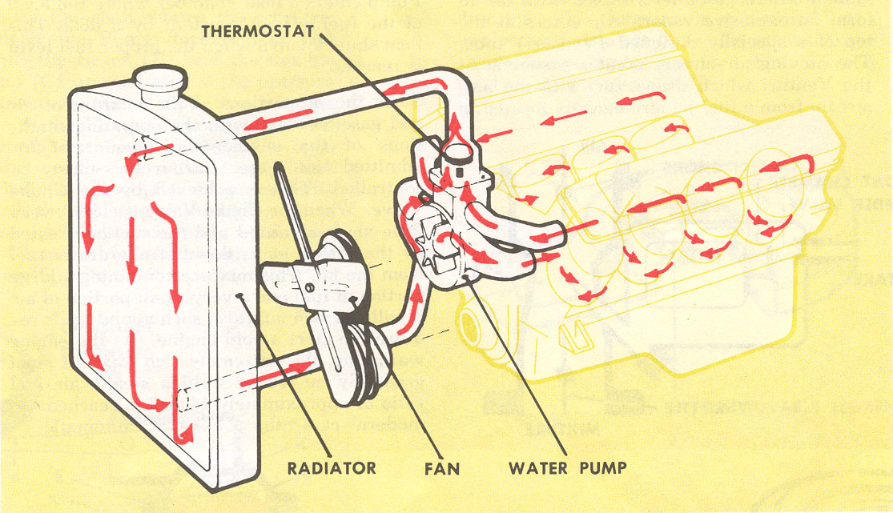

Slide 12
Thank You
For any concerns, please contact
elearning@knust.edu.gh
elearningknust@gmail.com
0322 191132

